Slide 1
Mining Rising Stars in Academic Graph
Alex(Yao) Lu
Microsoft Academic Search Project

Slide 2
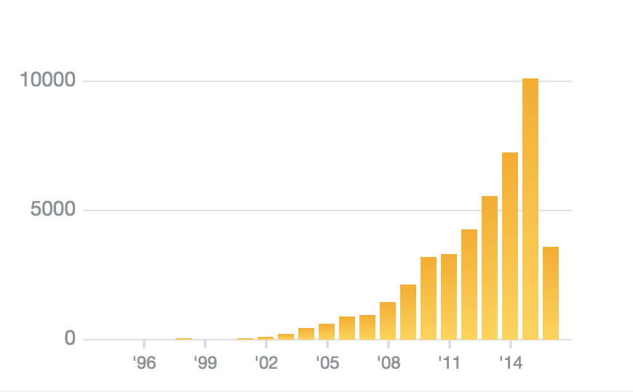
Traditional Methods
H-index
Citation Number
G-index
Depend heavily on citation number
Not suitable for young researchers with few academic experiences

Slide 3
Rising Star
Young researcher
Cooperate with experienced researchers
Publish a lot in prestigious venues

Slide 4
Academic Cooperation
 | A | B
Total Publication | 8 | 43
Citation Number | 113 | 2291
Cooperate Paper Number | 6
Weight of Directed Edges | From A to B: 113*6/8 = 84.75 | From B to A: 2291*6/43 =319
The citation number feature has been ignored in the existing methods[1][2]
Why?
[1] Li, Xiao-Li, et al. "Searching for rising stars in bibliography networks." International Conference on Database Systems for Advanced Applications. Springer Berlin Heidelberg, 2009.
[2] Daud, Ali, Rashid Abbasi, and Faqir Muhammad. "Finding rising stars in social networks." International Conference on Database Systems for Advanced Applications. Springer Berlin Heidelberg, 2013.

Slide 5
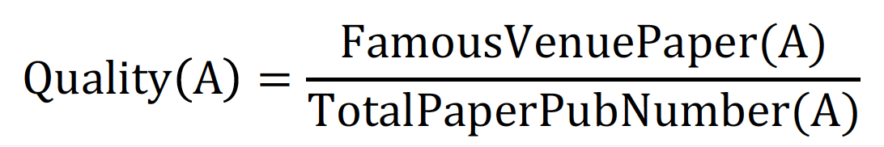
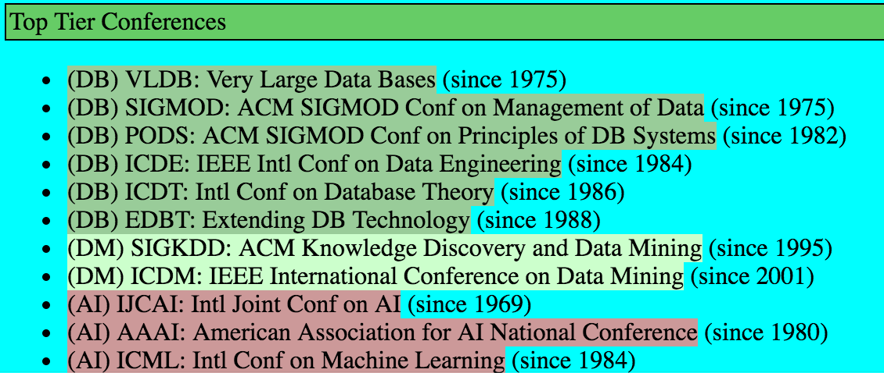
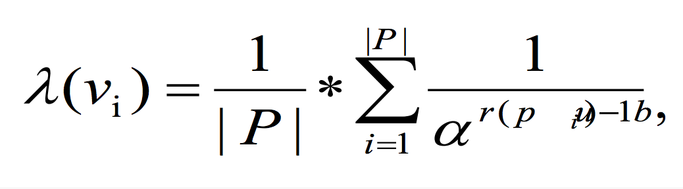
Academic Quality
Select Top Conference and Journals in CS
Calculate the overall Academic Quality Score of Authors
NTU Conference Ranking
CCF Ranking
Google Scholar Metrics
Microsoft Conference Ranking

Slide 6
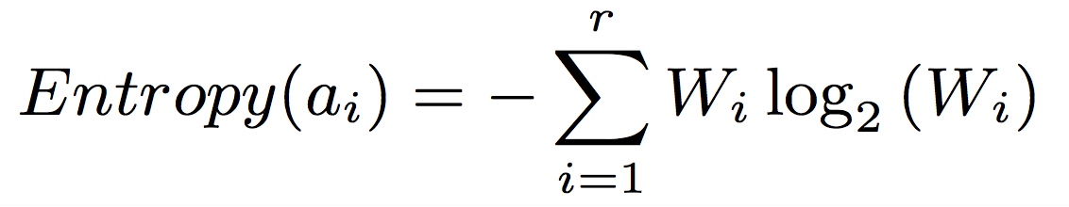
Additional Features
WWW 16’
Entropy of Authors’ Cooperation Network[1]
Presumption: Authors may benefit from cooperation with authors from different fields
Method: Using the user key word to evaluate the diversity background of its’ co-authors
Can we extract some features to evaluate the diversity of a young researcher’s overall publications?
Is it possible for us to evaluate the similarity of authors to divide them into some specific research areas?
[1] Zhang, Jun, et al. "Cocarank: A collaboration caliber-based method for finding academic rising stars." Proceedings of the 25th International Conference Companion on World Wide Web. International World Wide Web Conferences Steering Committee, 2016.

Slide 7
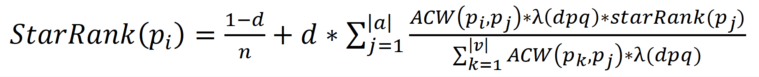
(*)Rank Algorithms
All based on PageRank

Slide 8
Datasets
Previous
Ours
DBLP Dataset[1][2]
Microsoft Academic Graph
Select time scale 1990-2000
Focus only on the top conference of NLP
(This can be further extended to other fields)
Noise data about the same publish name
Consider Reference from top conference and
other conferences separately
APS Physics Publication Dataset[3]
Using publication data from 14 aps journals
All the conferences and authors have a unique id
Select Academic experience < 5 years
[1] Li, Xiao-Li, et al. "Searching for rising stars in bibliography networks." International Conference on Database Systems for Advanced Applications. Springer Berlin Heidelberg, 2009.
[2] Daud, Ali, Rashid Abbasi, and Faqir Muhammad. "Finding rising stars in social networks." International Conference on Database Systems for Advanced Applications. Springer Berlin Heidelberg, 2013.
[3] Zhang, Jun, et al. "Cocarank: A collaboration caliber-based method for finding academic rising stars." Proceedings of the 25th International Conference Companion on World Wide Web. International World Wide Web Conferences Steering Committee, 2016.

Slide 9
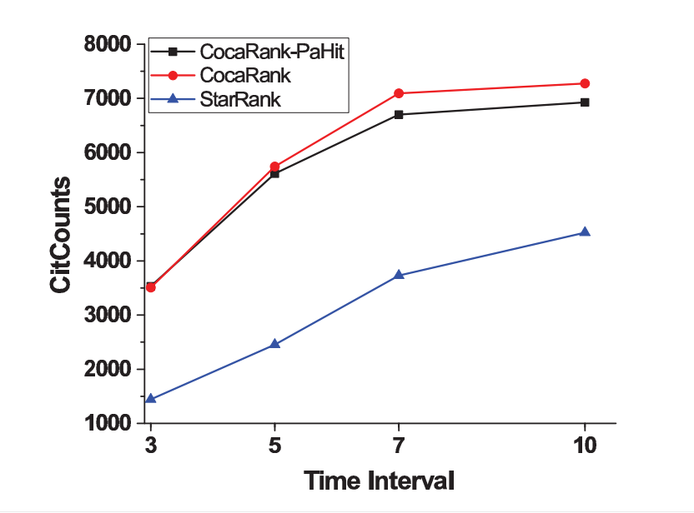
Evaluation
Previous
Ours
Using top authors’ citation number to evaluate
Using more traditional methods(H-index, G-index)
Lack of ground-truth dataset(its controversial)
Using human-annotation data for evaluation?
It can be tricky!
Any other methods? The previous work
cannot be used for benchmark
[1] Daud, Ali, Rashid Abbasi, and Faqir Muhammad. "Finding rising stars in social networks." International Conference on Database Systems for Advanced Applications. Springer Berlin Heidelberg, 2013.
[2] Zhang, Jun, et al. "Cocarank: A collaboration caliber-based method for finding academic rising stars." Proceedings of the 25th International Conference Companion on World Wide Web. International World Wide Web Conferences Steering Committee, 2016.

Slide 10
Unsolved Problems
Split the fields!
Citation Number and Successive Publication
The more researchers, the rank will be higher
It’s unfair to compute all the fields together
Jiwei Li can definitely be considered as
a rising star in NLP only based on publication
Quality
Jiawei Han: <0.8
Eduard Hovy: <0.9
Jiwei Li Quality Score: 1.0
Field
Jiawei Han: Data Mining
Eduard Hovy: NLP
Jiwei Li : NLP
Lack of benchmark dataset
Microsoft Academic Graph(MAG) is good for research
A Convincing Evaluation Method
But finally they rank together in the *rank algorithms
The citation number shouldn't be used alone to evaluate the performance of a algorithm

